Slide 1

Lending Club Loan Analysis
Pierina Marie LogroÑo

Slide 2
LENDING CLUB DATASET
CSV File from Kaggle.com
Lending club loans data from 2007 to 2015.
9,578 records (rows)
14 columns that include categorical, strings and continuous variables

Slide 3
End user
Consumer that does their research before making big decisions
Consumer is thinking about taking out a loan for the first time and wants to know what it takes

Slide 4
LENDING CLUB DATASET
For our Analysis:
Hypothesis 1
Int.rate: continuous variable - interest rate of the loan
Purpose: continuous string – why the loan is being taken out
Hypothesis 2
Credit.policy: categorical variable - If borrower meets underwriting policy = “1”, otherwise “0”
Fico: continuous variable – borrower’s FICO credit score

Slide 5
Hypothesis 1
H0: µ1-µ2=0 : There is no difference between sample mean of interest rates for small business loans and sample mean of interest rates for major purchase loans.
Ha: µ1-µ2≠0 :There is a difference between sample mean of interest rates for small business loans and sample mean of interest rates for major purchase loans.

Slide 6
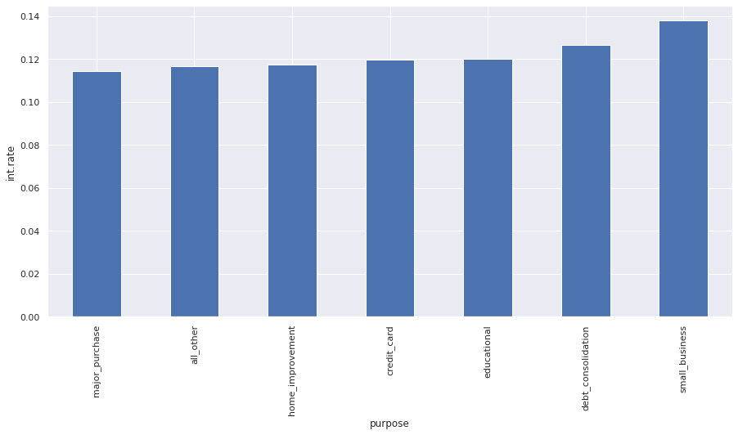
Hypothesis 1
int.rate
purpose
major_purchase 0.114171
all_other 0.116771
home_improvement 0.117507
credit_card 0.119738
educational 0.119907
debt_consolidation 0.126595
small_business 0.138087

Slide 7
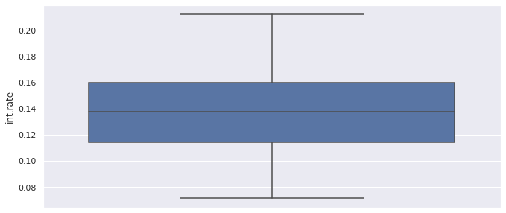
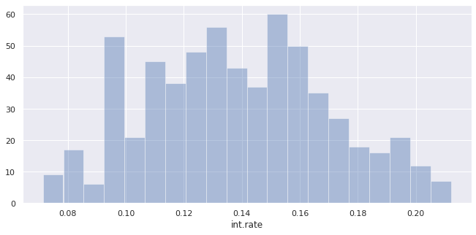
Small_business_group sample distribution

Slide 8
Small_business_group Descriptive Statistics
count 619.000000
mean 0.138087
std 0.031191
min 0.071400
25% 0.114600
50% 0.137900
75% 0.160000
max 0.212100

Slide 9
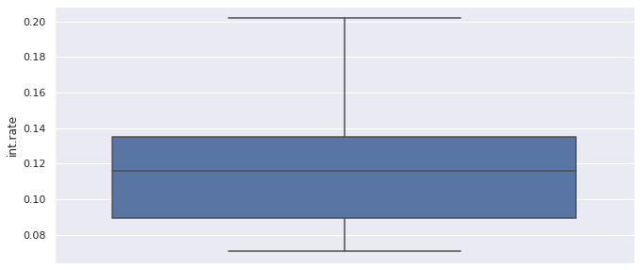
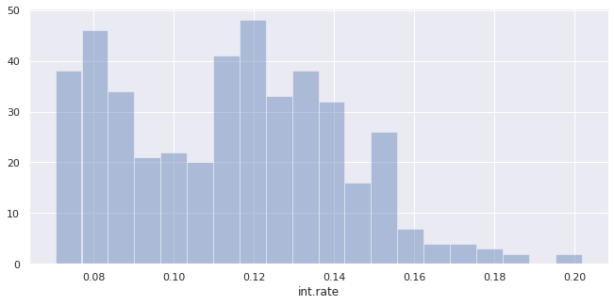
Major_purchase_group sample distribution

Slide 10
Major_purchase_group Descriptive Statistics
count 437.000000
mean 0.114171
std 0.027445
min 0.070500
25% 0.089400
50% 0.115800
75% 0.134800
max 0.201700

Slide 11
Computations
Two sample t-test for small_business group and major_purchase group
Ttest_indResult(statistic=12.888579753668804, pvalue=2.1112866852330368e-35)
Total sample size, mean and variance
Calculate Standard of error and Confidence Intervals

Slide 12
Results for first Sample test
Reject the Null Hypothesis
The difference is significant at p<0.05 level
The difference between the two-sample means is between 0.02036 and 0.02747 at a 95% confidence.

Slide 13
Hypothesis 2
H0: µ1-µ2=0 : There is no difference between sample mean of FICO scores that do not meet the underwriting policy and the sample mean of FICO scores that do meet the underwriting policy.
Ha: µ1-µ2≠0 :There is a difference between sample mean of FICO scores that do not meet the underwriting policy and the sample mean of FICO scores that do meet the underwriting policy.

Slide 14
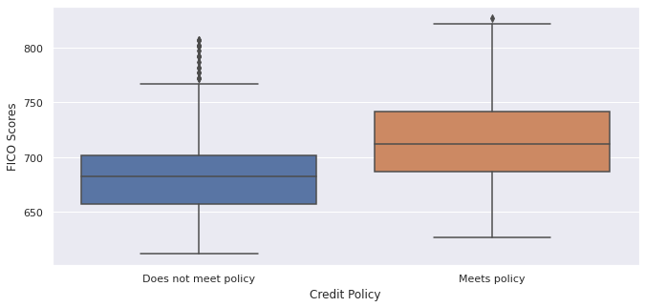
Comparison of both samples

Slide 15
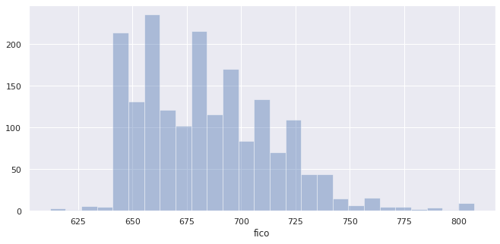
Distribution of FICO_0_policy sample

Slide 16
FICO_0_policy Descriptive Statistics
count 1868.000000
mean 683.978051
std 30.950970
min 612.000000
25% 657.000000
50% 682.000000
75% 702.000000
max 807.000000

Slide 17
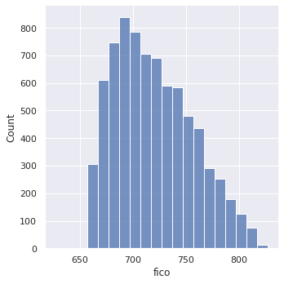
Distribution of FICO_1_policy sample

Slide 18
FICO_1_policy Descriptive Statistics
count 7710.000000
mean 717.356031
std 36.630697
min 627.000000
25% 687.000000
50% 712.000000
75% 742.000000
max 827.000000

Slide 19
Computations
Two sample t-test for FICO_0_policy sample and FICO_1_policy sample
Ttest_indResult(statistic=-36.36259987408664, pvalue=2.6100416830751396e-271)
Total sample size, mean and variance
Calculate Standard of error and Confidence Intervals

Slide 20
Results for second Sample test
Reject the Null Hypothesis
The difference is significant at p<0.05 level
The difference between the two-sample means is between 35.0024 and 31.7536 at a 95% confidence.

Slide 21
Conclusion
First Hypothesis: We can clearly see that the purpose of the loan does affect interest rate.
Second Hypothesis: We can see that FICO scores clearly have an affect on the borrower’s chances of meeting Lending Club’s underwriting policy.
Here in America, credit score tells a lot about a person.
As a consumer, do your research!

Slide 22

Questions

